Slide 1
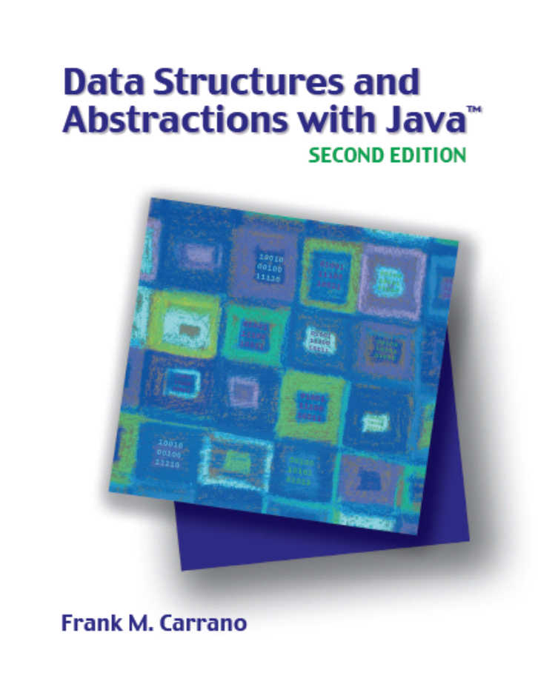

Trees
Chapter 25
Slides by Steve Armstrong
LeTourneau University
Longview, TX
© 2007, Prentice Hall

Slide 2
Chapter Contents
Tree Concepts
  Hierarchical Organizations
  Tree Terminology
Traversals of a Tree
  Traversals of a Binary Tree
  Traversals of a General Tree
Java Interfaces for Trees
  Interfaces for All Trees
  An Interface for Binary Trees
Carrano, Data Structures and Abstractions with Java, Second Edition, (c) 2007 Pearson Education, Inc. All rights reserved. 0-13-237045-X

Slide 3
Chapter Contents
Examples of Binary Trees
  Expression Trees
  Decision Trees
  Binary Search Trees
  Heaps
Examples of General Trees
  Parse Trees
  Game Trees
Carrano, Data Structures and Abstractions with Java, Second Edition, (c) 2007 Pearson Education, Inc. All rights reserved. 0-13-237045-X

Slide 4
Tree Concepts
Previous data organizations place data in linear order
Some data organizations require categorizing data into groups, subgroups
This is hierarchical classification
  Data items appear at various levels within the organization
Carrano, Data Structures and Abstractions with Java, Second Edition, (c) 2007 Pearson Education, Inc. All rights reserved. 0-13-237045-X

Slide 5
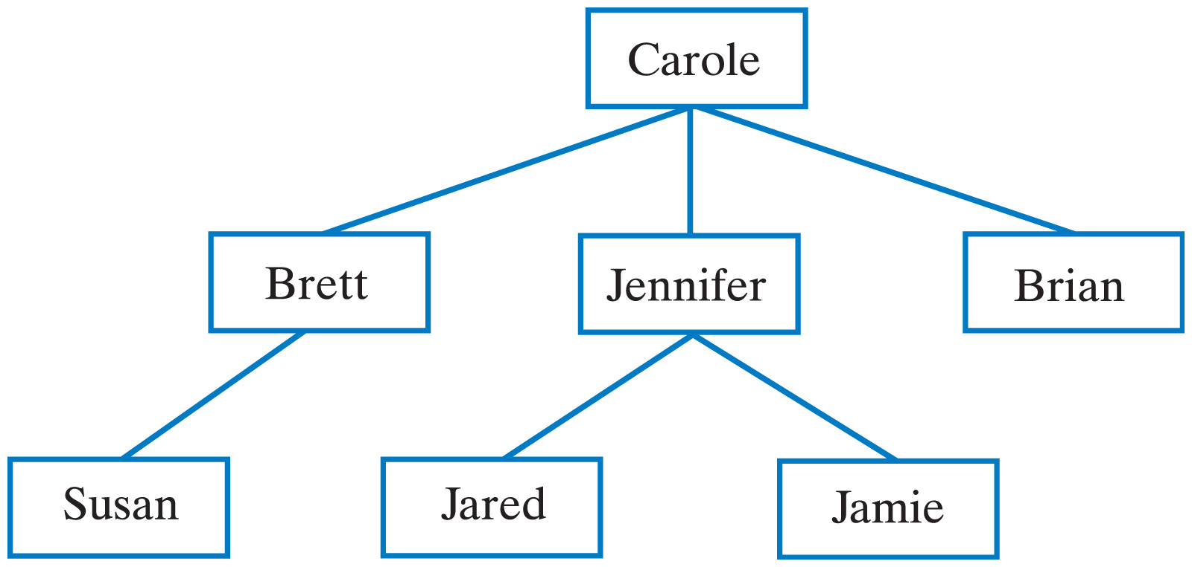
Hierarchical Organization
Example: Family trees
Fig. 25-1 Carole's children and grandchildren.
Carrano, Data Structures and Abstractions with Java, Second Edition, (c) 2007 Pearson Education, Inc. All rights reserved. 0-13-237045-X

Slide 6
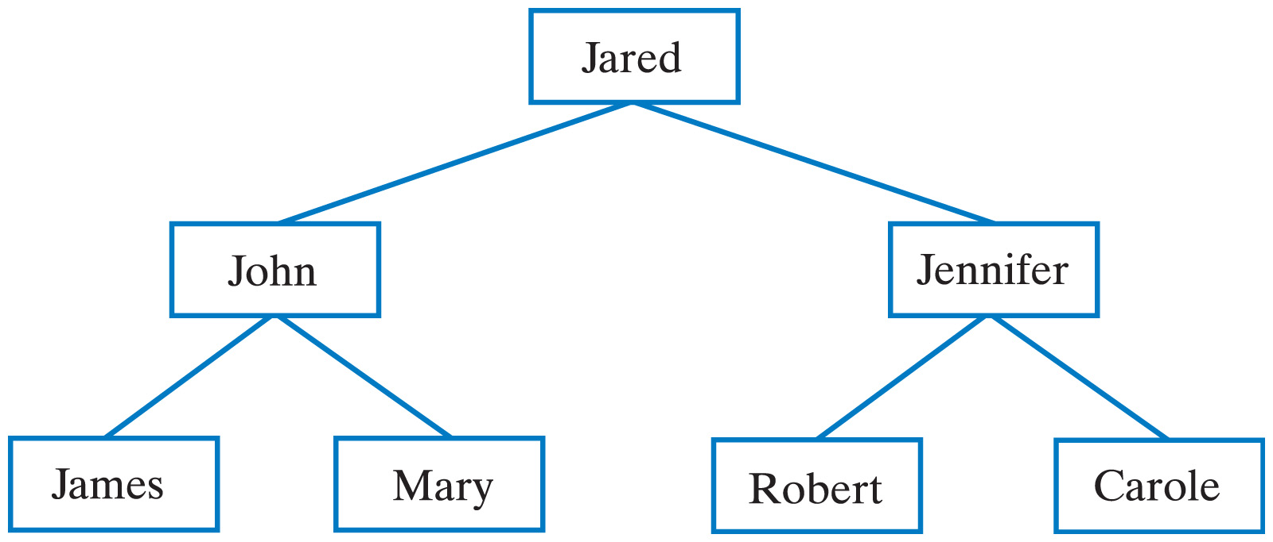
Hierarchical Organization
Example: Family trees
Fig. 25-2 Jared's parents and grandparents.
Carrano, Data Structures and Abstractions with Java, Second Edition, (c) 2007 Pearson Education, Inc. All rights reserved. 0-13-237045-X

Slide 7
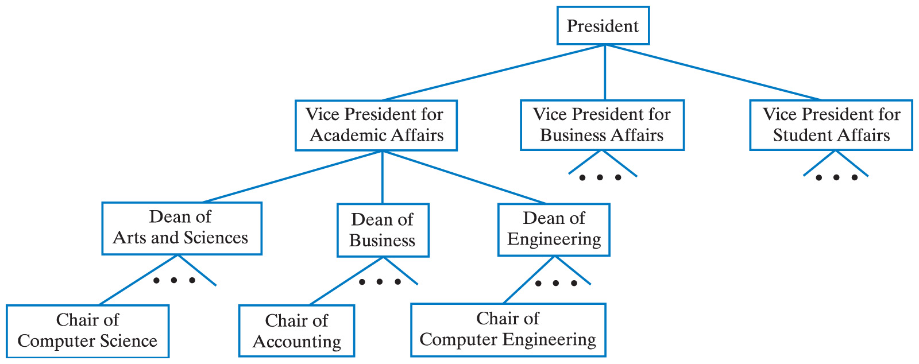
Hierarchical Organization
Example: A university's organization
Fig. 25-3 A university's administrative structure.
Carrano, Data Structures and Abstractions with Java, Second Edition, (c) 2007 Pearson Education, Inc. All rights reserved. 0-13-237045-X

Slide 8
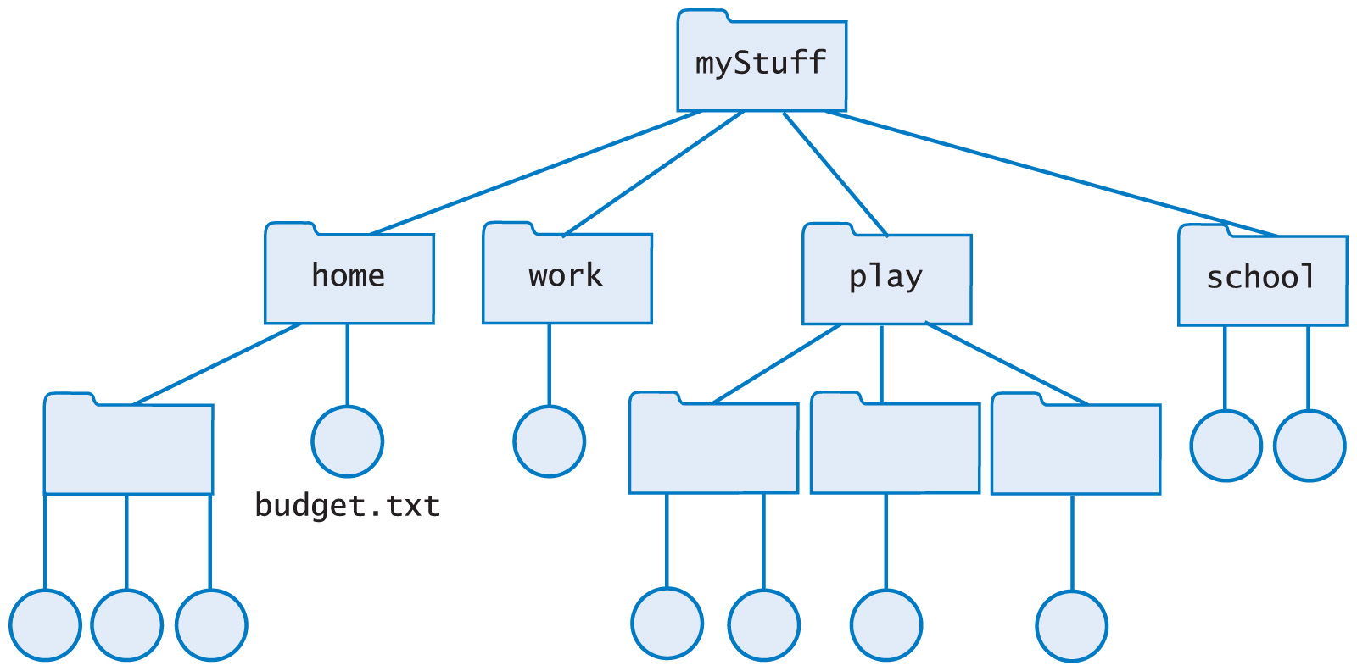
Hierarchical Organization
Example: File Directories
Fig. 25-4 Computer files organized into folders
Carrano, Data Structures and Abstractions with Java, Second Edition, (c) 2007 Pearson Education, Inc. All rights reserved. 0-13-237045-X

Slide 9
Tree Terminology
A tree is
  A set of nodes
  Connected by edges
The edges indicate relationships among nodes
Nodes arranged in levels
  Indicate the nodes' hierarchy
  Top level is a single node called the root
Carrano, Data Structures and Abstractions with Java, Second Edition, (c) 2007 Pearson Education, Inc. All rights reserved. 0-13-237045-X

Slide 10
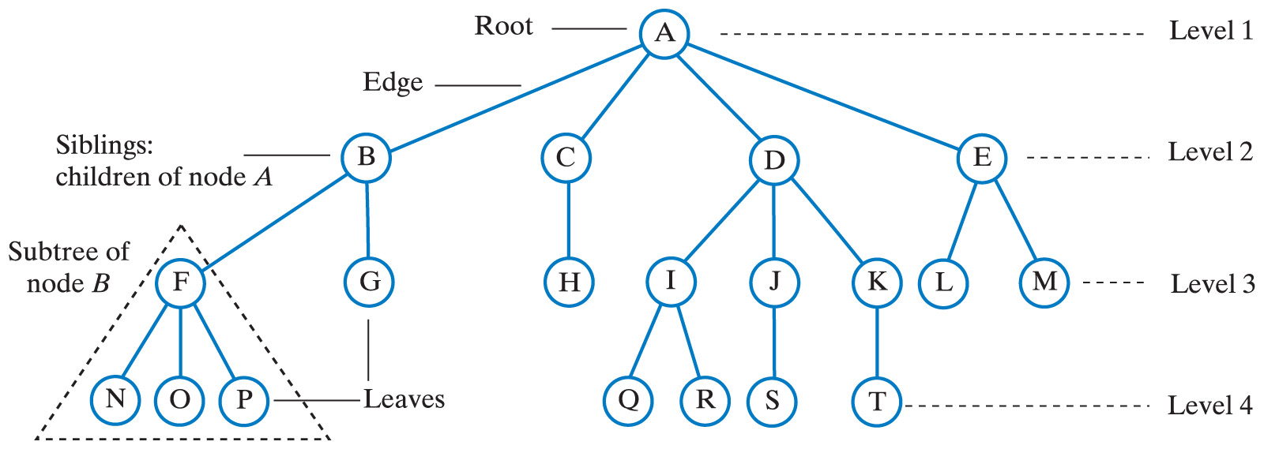
Tree Terminology
Fig. 25-5 A tree equivalent to the tree in Fig. 25-4
Carrano, Data Structures and Abstractions with Java, Second Edition, (c) 2007 Pearson Education, Inc. All rights reserved. 0-13-237045-X

Slide 11
Tree Terminology
Nodes at a given level are children of nodes of previous level
Node with children is the parent node of those children
Nodes with same parent are siblings
Node with no children is a leaf node
The only node with no parent is the root node
  All others have one parent each
Carrano, Data Structures and Abstractions with Java, Second Edition, (c) 2007 Pearson Education, Inc. All rights reserved. 0-13-237045-X

Slide 12
Tree Terminology
Empty trees?
  Some authors specify a general tree must have at least the root node
  This text will allow all trees to be empty
A node is reached from the root by a path
  The length of the path is the number of edges that compose it
The height of a tree is the number of levels in the tree
The subtree of a node is a tree rooted at a child of that node
Carrano, Data Structures and Abstractions with Java, Second Edition, (c) 2007 Pearson Education, Inc. All rights reserved. 0-13-237045-X

Slide 13
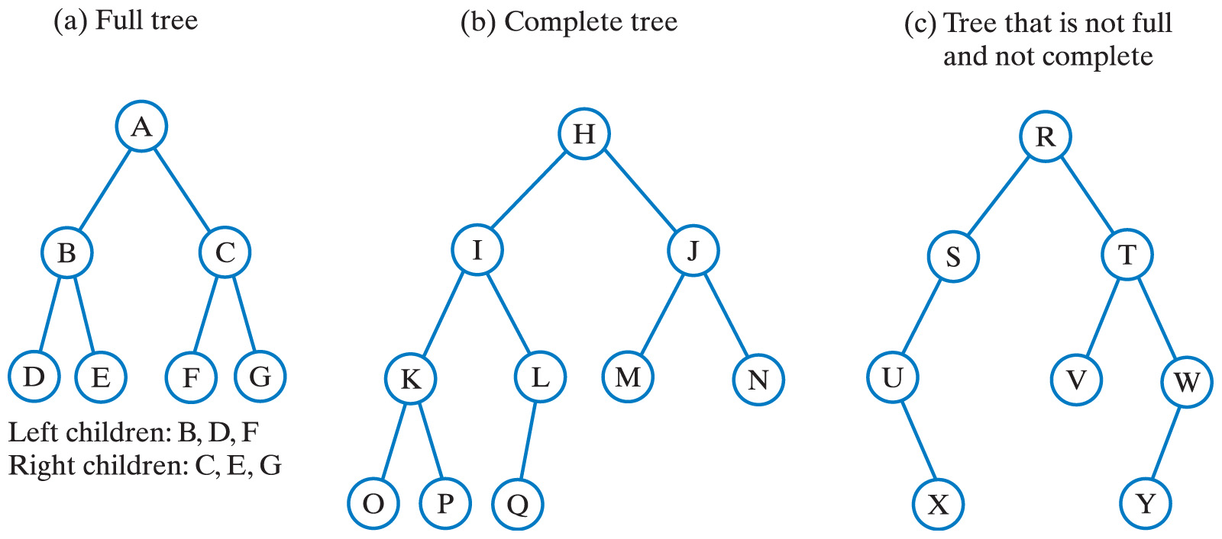
Binary Trees
Each node has at most two children
Fig. 25-6 Three binary trees.
Carrano, Data Structures and Abstractions with Java, Second Edition, (c) 2007 Pearson Education, Inc. All rights reserved. 0-13-237045-X

Slide 14
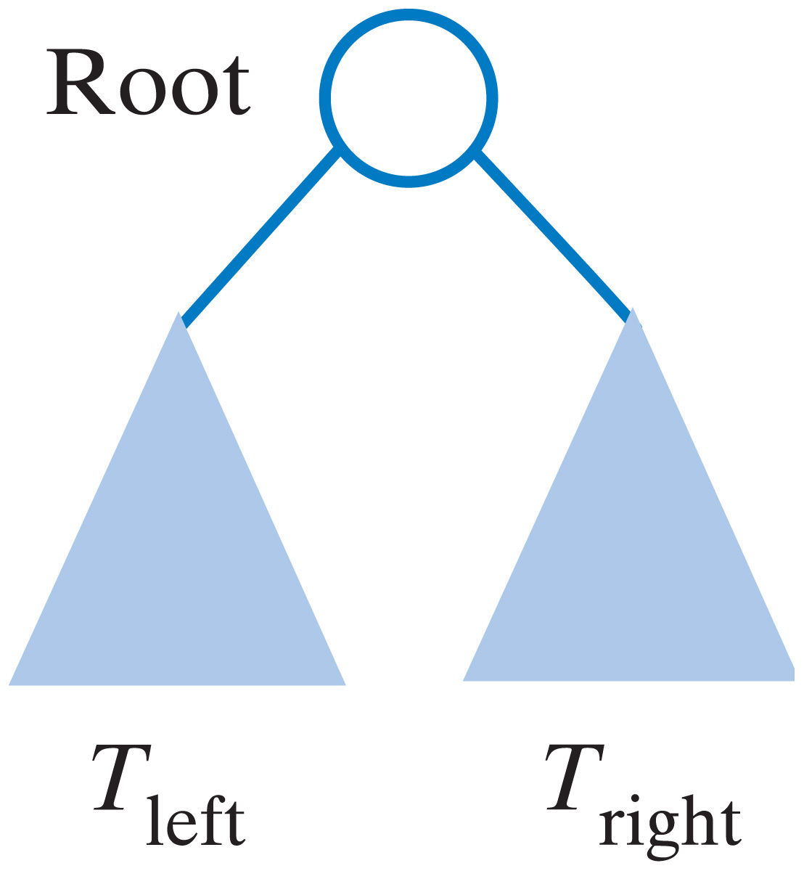
Binary Trees
A binary tree is either empty or has the following form
  Where T_{left} and T_{right} are binary trees
Carrano, Data Structures and Abstractions with Java, Second Edition, (c) 2007 Pearson Education, Inc. All rights reserved. 0-13-237045-X

Slide 15
Binary Trees
Every nonleaf in a full binary tree has exactly two children
A complete binary tree is full to its next-to-last level
  Leaves on last level filled from left to right
The height of a binary tree with n nodes that is either complete or full is
log₂(n + 1)
Carrano, Data Structures and Abstractions with Java, Second Edition, (c) 2007 Pearson Education, Inc. All rights reserved. 0-13-237045-X

Slide 16
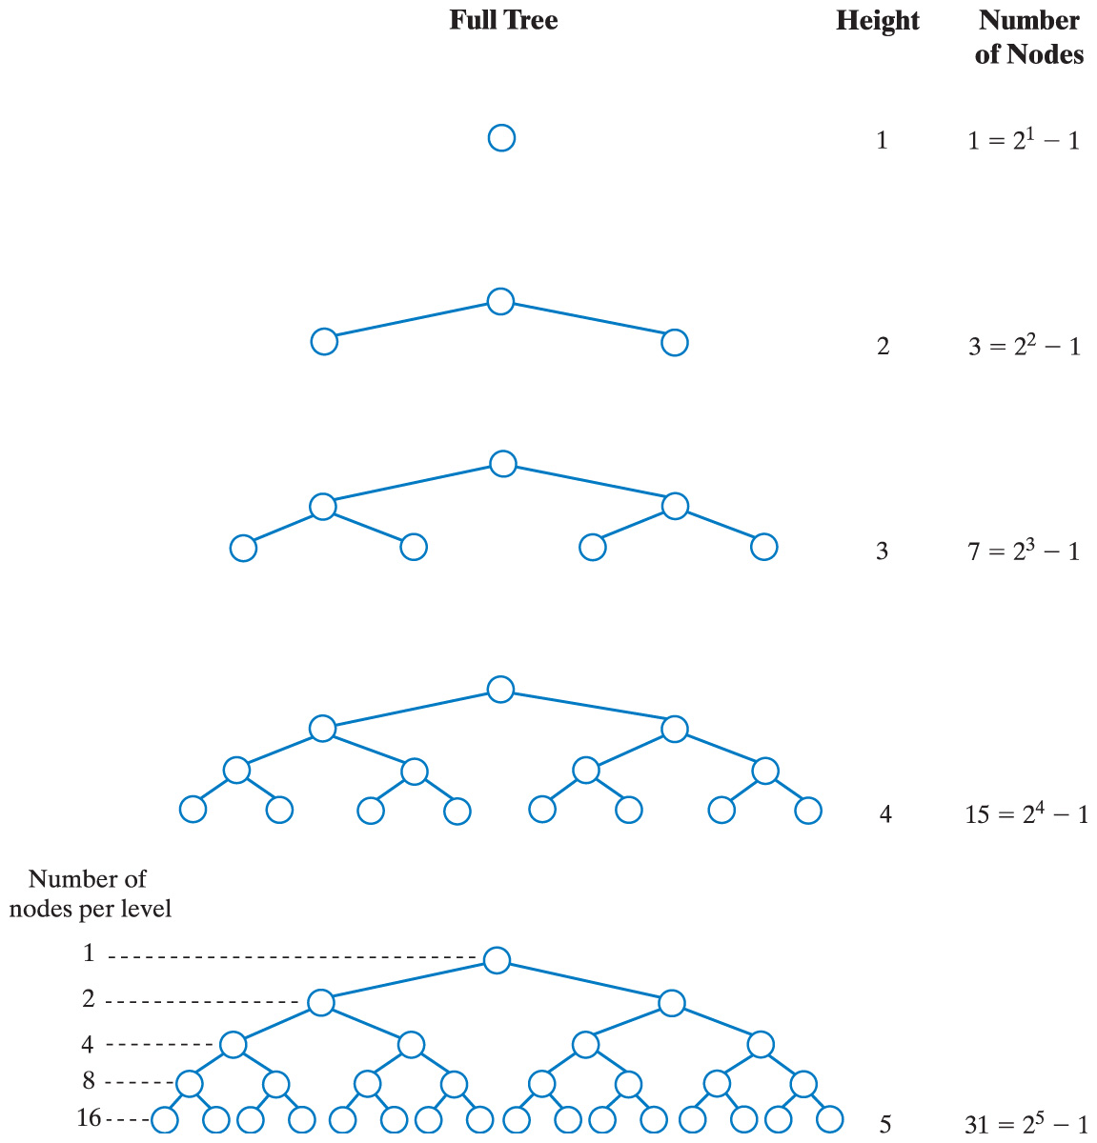
Binary
Trees
Full Tree Height Number
of Nodes
Fig. 25-7 The number of nodes in a full binary tree as a function of the tree's height.
Carrano, Data Structures and Abstractions with Java, Second Edition, (c) 2007 Pearson Education, Inc. All rights reserved. 0-13-237045-X

Slide 17
Binary Trees
Full Tree Height Number
of Nodes
Fig. 25-7 The number of nodes in a full binary tree as a function of the tree's height.
Carrano, Data Structures and Abstractions with Java, Second Edition, (c) 2007 Pearson Education, Inc. All rights reserved. 0-13-237045-X

Slide 18
Traversals of a Tree
Visiting a node
  Processing the data within a node
This is the action performed on each node during traversal of a tree
A traversal can pass through a node without visiting it at that moment
For a binary tree
  Visit the root
  Visit all nodes in the root's left subtree
  Visit all nodes in the root's right subtree
Carrano, Data Structures and Abstractions with Java, Second Edition, (c) 2007 Pearson Education, Inc. All rights reserved. 0-13-237045-X

Slide 19
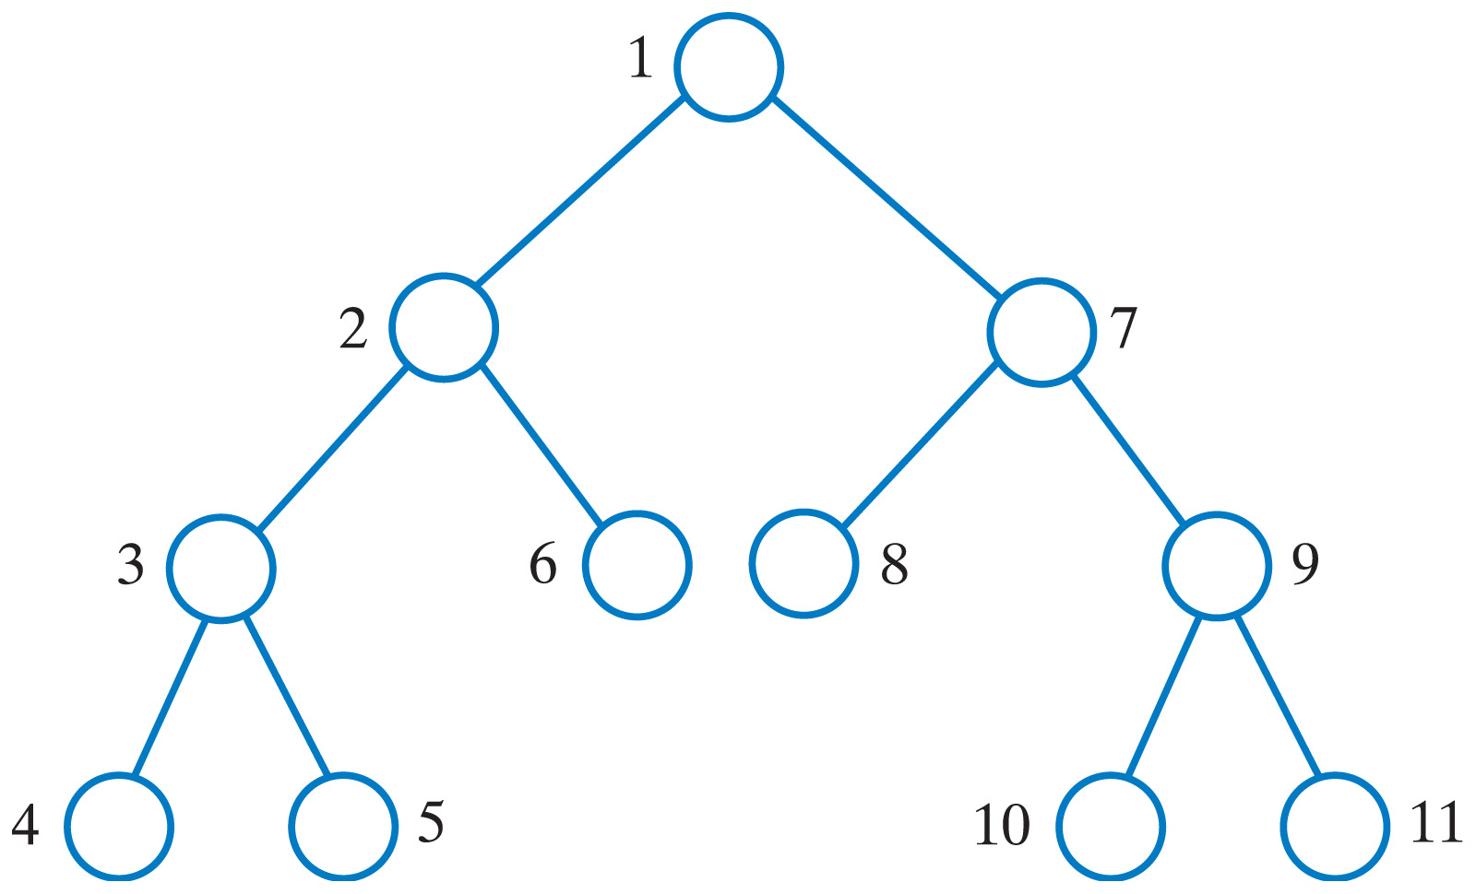
Traversals of a Tree
Preorder traversal: visit root before the subtrees
Fig. 25-8 The visitation order of a preorder traversal.
Carrano, Data Structures and Abstractions with Java, Second Edition, (c) 2007 Pearson Education, Inc. All rights reserved. 0-13-237045-X

Slide 20
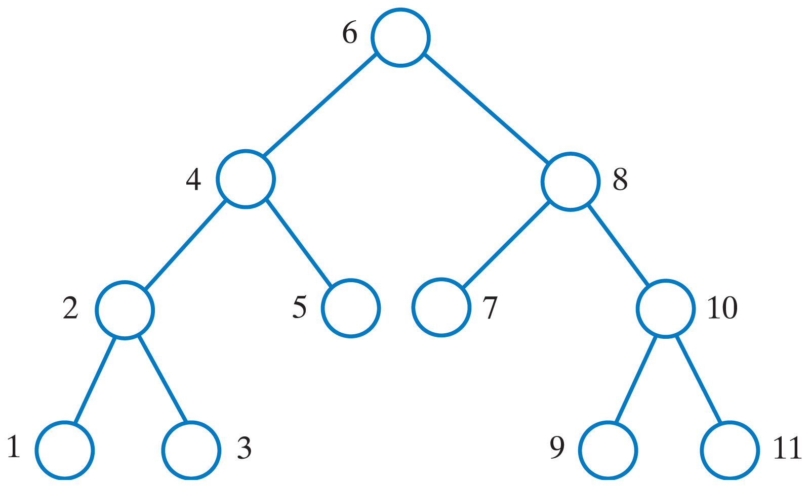
Traversals of a Tree
Inorder traversal: visit root between visiting the subtrees
Fig. 25-9 The visitation order of an inorder traversal.
Carrano, Data Structures and Abstractions with Java, Second Edition, (c) 2007 Pearson Education, Inc. All rights reserved. 0-13-237045-X

Slide 21
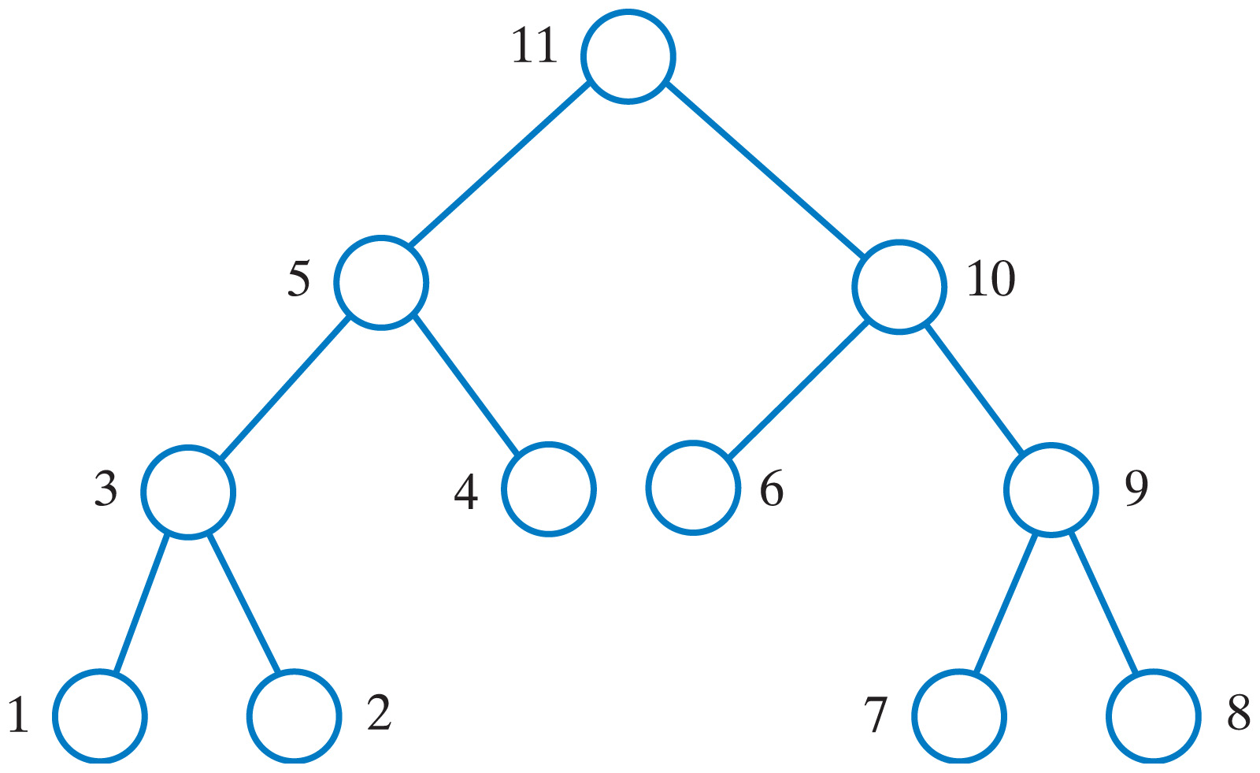
Traversals of a Tree
Postorder traversal: visit root after visiting the subtrees
These are examples of a depth-first traversal.
Fig. 25-10 The visitation order of a postorder traversal.
Carrano, Data Structures and Abstractions with Java, Second Edition, (c) 2007 Pearson Education, Inc. All rights reserved. 0-13-237045-X

Slide 22
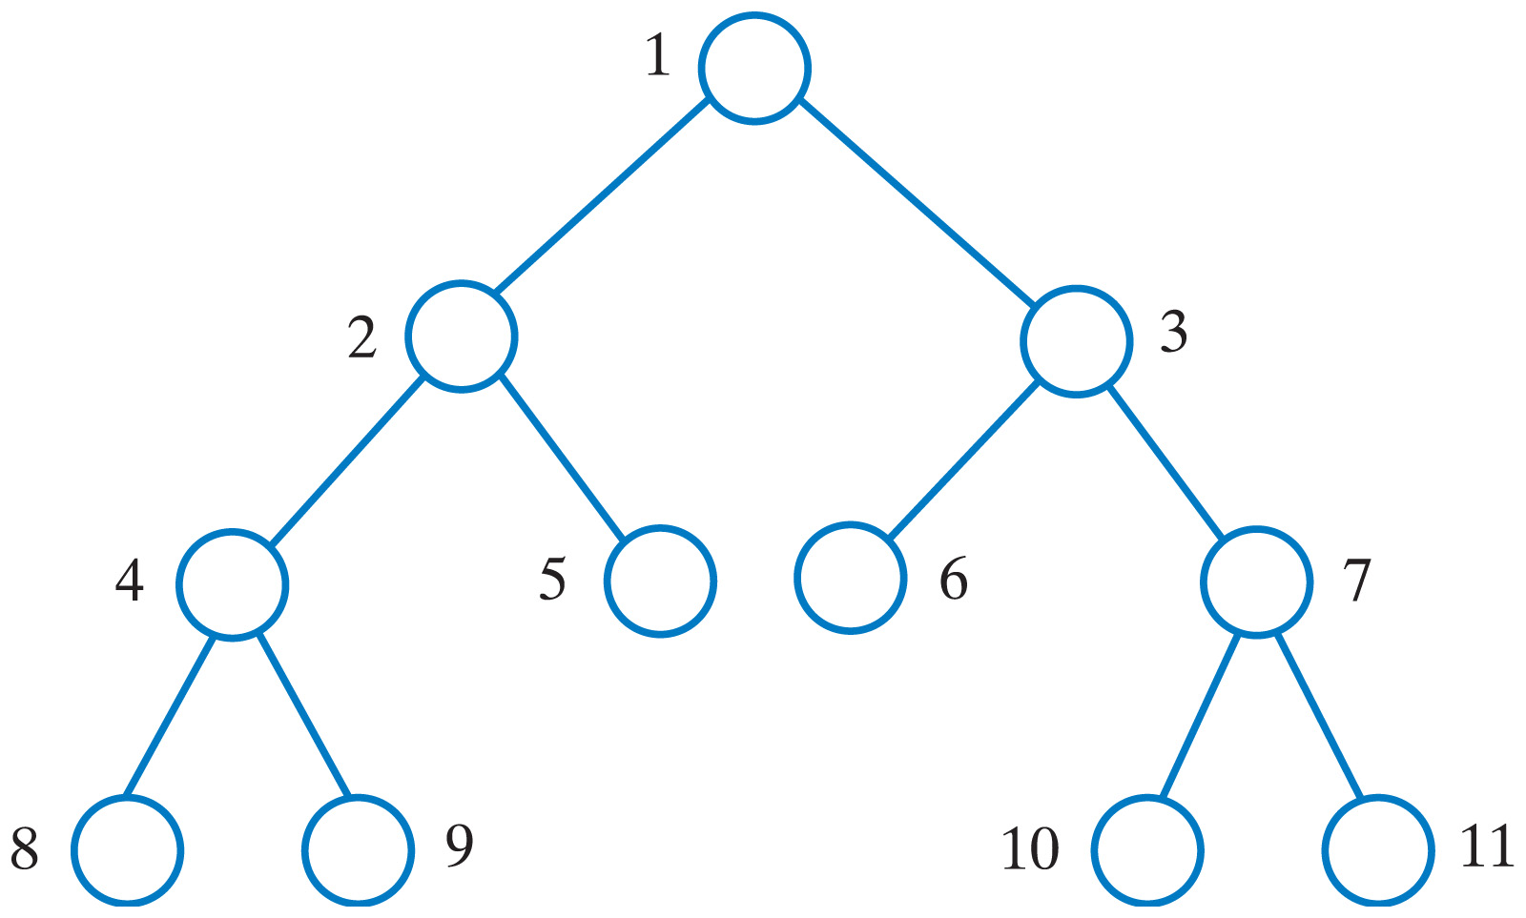
Traversals of a Tree
Level-order traversal: begin at the root, visit nodes one level at a time
This is an example of a breadth-first traversal.
Fig. 25-11 The visitation order of a level-order traversal.
Carrano, Data Structures and Abstractions with Java, Second Edition, (c) 2007 Pearson Education, Inc. All rights reserved. 0-13-237045-X

Slide 23
Traversals of a General Tree
A general tree has traversals that are in
  Level order
  Preorder
  Postorder
Inorder traversal not well defined for a general tree
Carrano, Data Structures and Abstractions with Java, Second Edition, (c) 2007 Pearson Education, Inc. All rights reserved. 0-13-237045-X

Slide 24
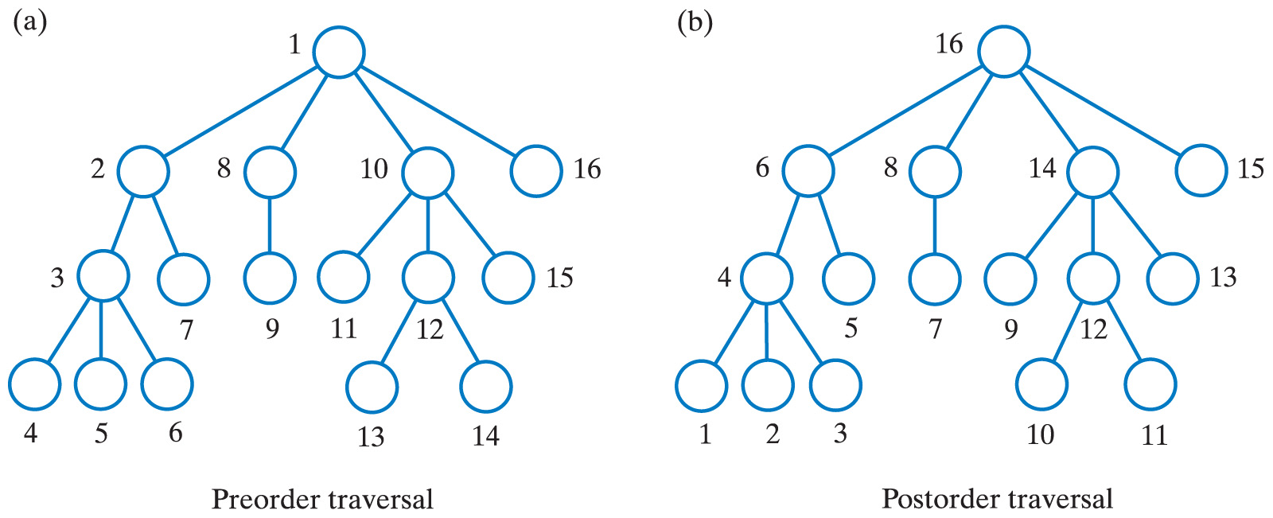
Traversals of a General Tree
Fig. 25-12 The visitation order of two traversals
of a general tree: (a) preorder.
Carrano, Data Structures and Abstractions with Java, Second Edition, (c) 2007 Pearson Education, Inc. All rights reserved. 0-13-237045-X

Slide 25
Traversals of a General Tree
Fig. 25-12 The visitation order of two traversals
of a general tree: (b) postorder.
Carrano, Data Structures and Abstractions with Java, Second Edition, (c) 2007 Pearson Education, Inc. All rights reserved. 0-13-237045-X

Slide 26
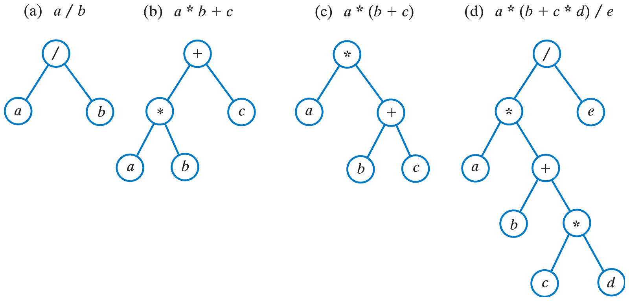
Examples of Binary Trees
Expression Trees
Click to view algorithm for evaluating an expression tree
Fig. 25-14 Expression trees for four algebraic expressions.
Carrano, Data Structures and Abstractions with Java, Second Edition, (c) 2007 Pearson Education, Inc. All rights reserved. 0-13-237045-X

Slide 27
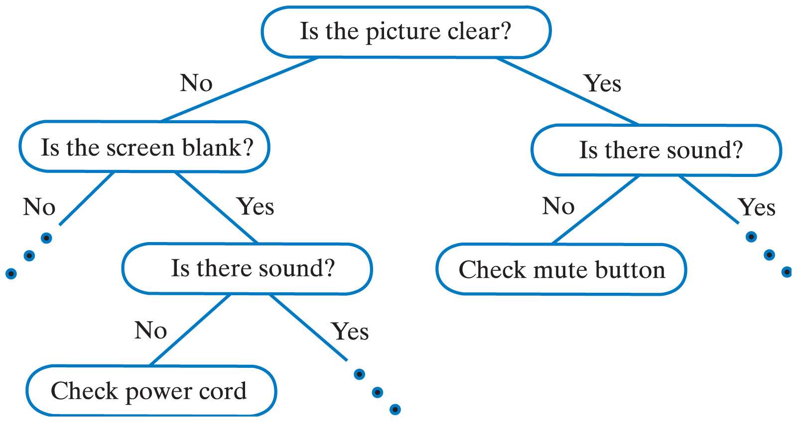
Decision Trees
A decision tree can be the basis of an expert system
  Helps users solve problems, make decisions
Fig. 25-15 A portion of a binary decision tree.
Carrano, Data Structures and Abstractions with Java, Second Edition, (c) 2007 Pearson Education, Inc. All rights reserved. 0-13-237045-X

Slide 28
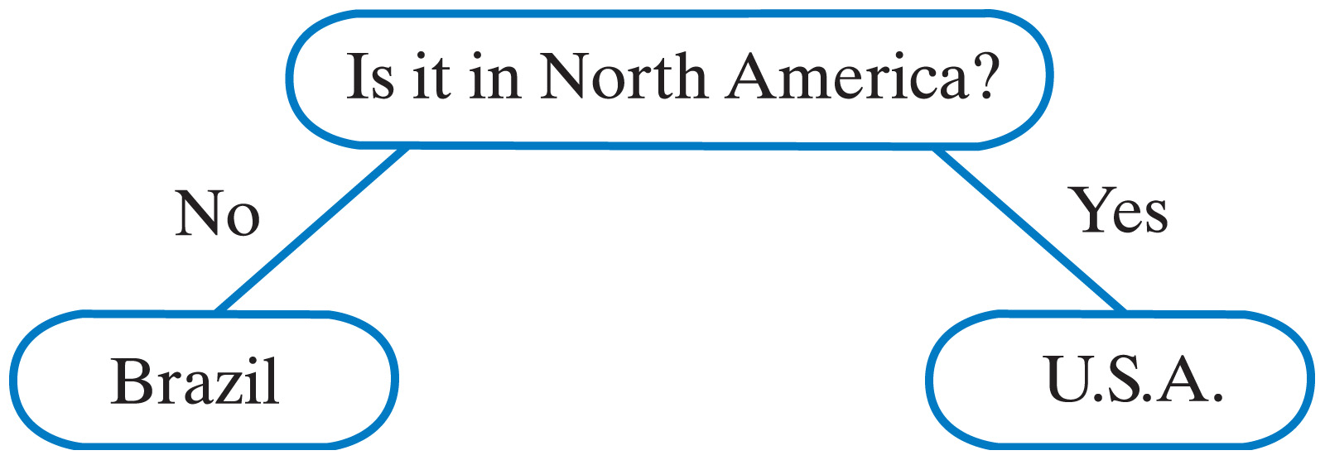
Decision Trees
View source code of interface for a binary decision tree
Example: a guessing game
Fig. 25-16 An initial decision tree for a guessing game.
Carrano, Data Structures and Abstractions with Java, Second Edition, (c) 2007 Pearson Education, Inc. All rights reserved. 0-13-237045-X

Slide 29
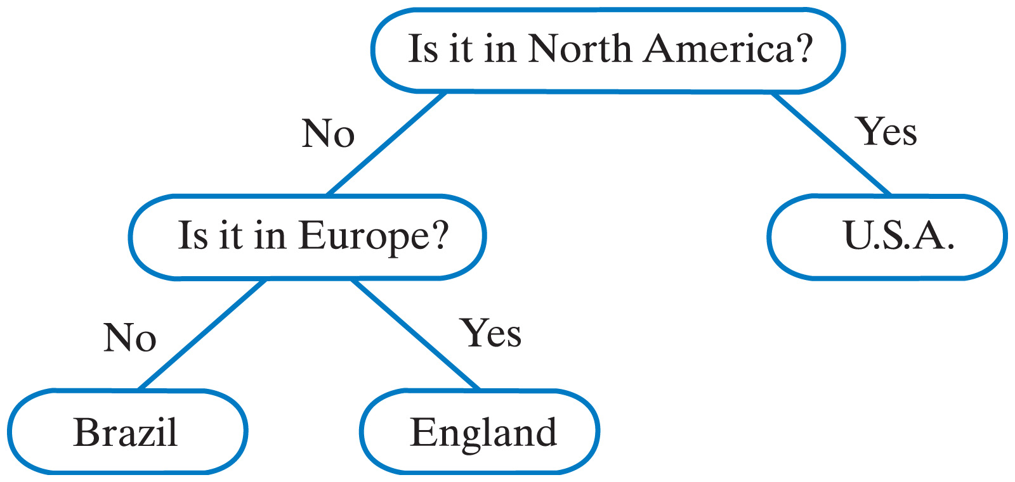
Decision Trees
Click to view the class GuessingGame
Fig. 25-17 The decision tree for a guessing game after acquiring another fact.
Carrano, Data Structures and Abstractions with Java, Second Edition, (c) 2007 Pearson Education, Inc. All rights reserved. 0-13-237045-X

Slide 30
Binary Search Trees
A search tree organizes its data so that a search is more efficient
Binary search tree
  Nodes contain Comparable objects
  A node's data is greater than the data in the node's left subtree
  A node's data is less than the data in the node's right subtree
Carrano, Data Structures and Abstractions with Java, Second Edition, (c) 2007 Pearson Education, Inc. All rights reserved. 0-13-237045-X

Slide 31
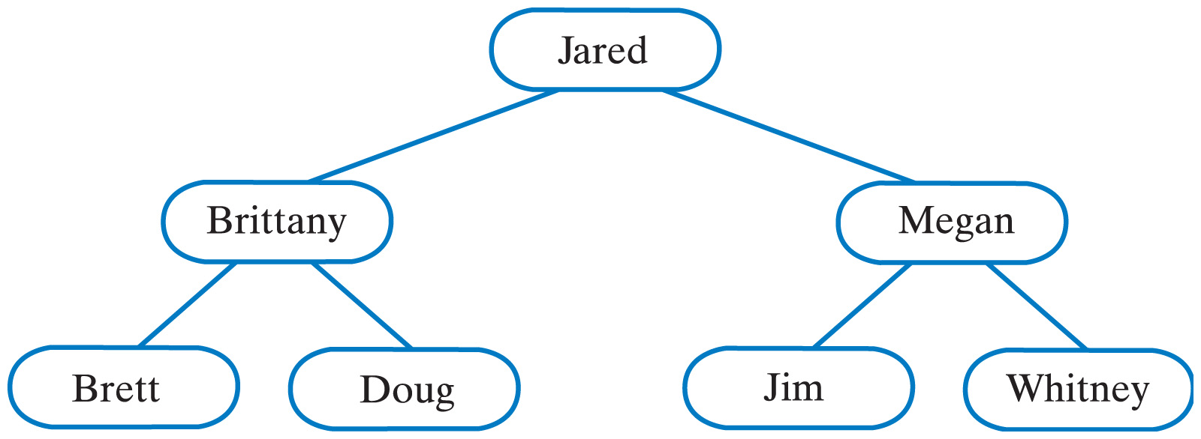
Binary Search Trees
Fig. 25-18 A binary search tree of names.
Carrano, Data Structures and Abstractions with Java, Second Edition, (c) 2007 Pearson Education, Inc. All rights reserved. 0-13-237045-X

Slide 32
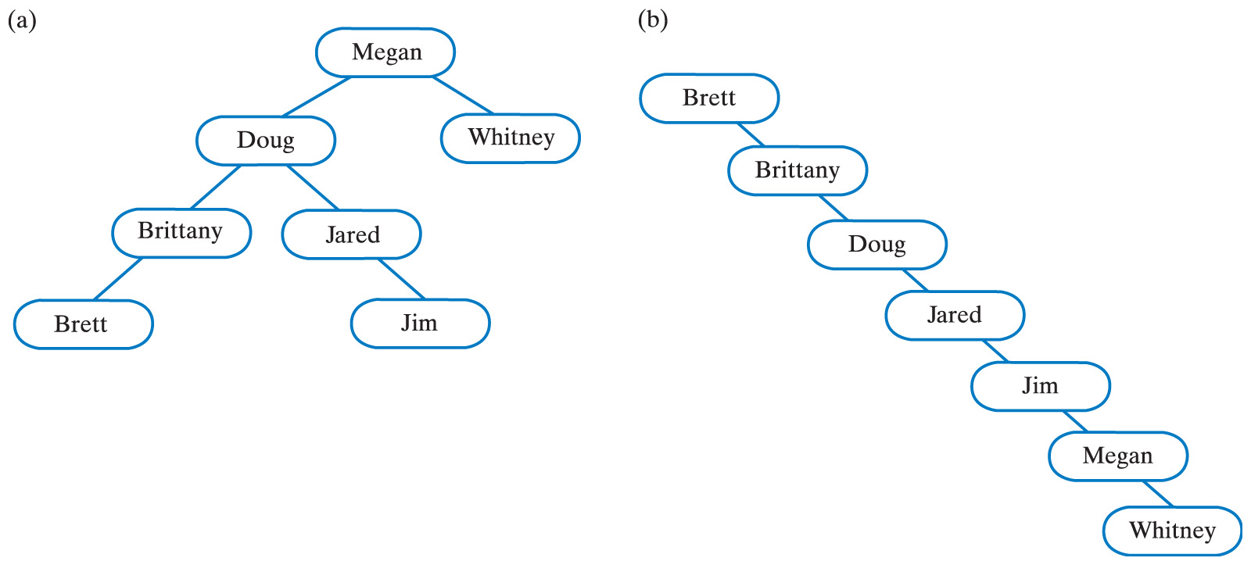
Binary Search Trees
Click to view algorithm for searching a binary tree
Fig. 25-19 Two binary search trees containing the same names as the tree in Fig. 25-18
Carrano, Data Structures and Abstractions with Java, Second Edition, (c) 2007 Pearson Education, Inc. All rights reserved. 0-13-237045-X

Slide 33
Heaps
A complete binary tree
  Nodes contain Comparable objects
  Each node contains no smaller (or no larger) than objects in its descendants
Maxheap
  Object in a node is ≥ its descendant objects
Minheap
  Object in a node is ≤ descendant objects
Carrano, Data Structures and Abstractions with Java, Second Edition, (c) 2007 Pearson Education, Inc. All rights reserved. 0-13-237045-X

Slide 34
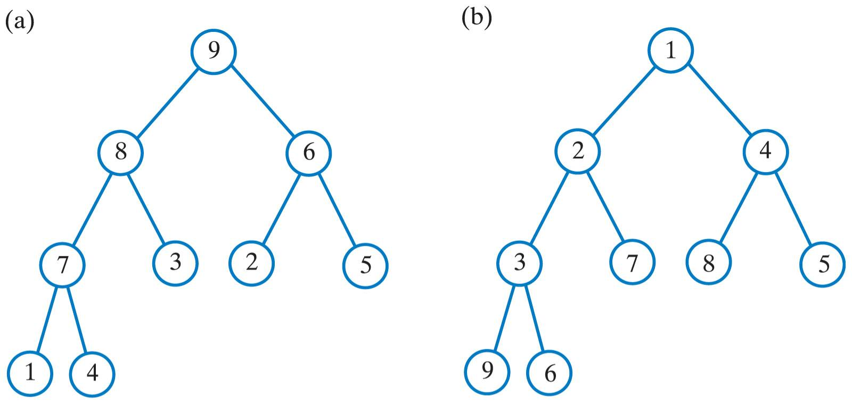
Heaps
Fig. 25-20 (a) A maxheap and (b) a minheap that contain the same values
Carrano, Data Structures and Abstractions with Java, Second Edition, (c) 2007 Pearson Education, Inc. All rights reserved. 0-13-237045-X

Slide 35
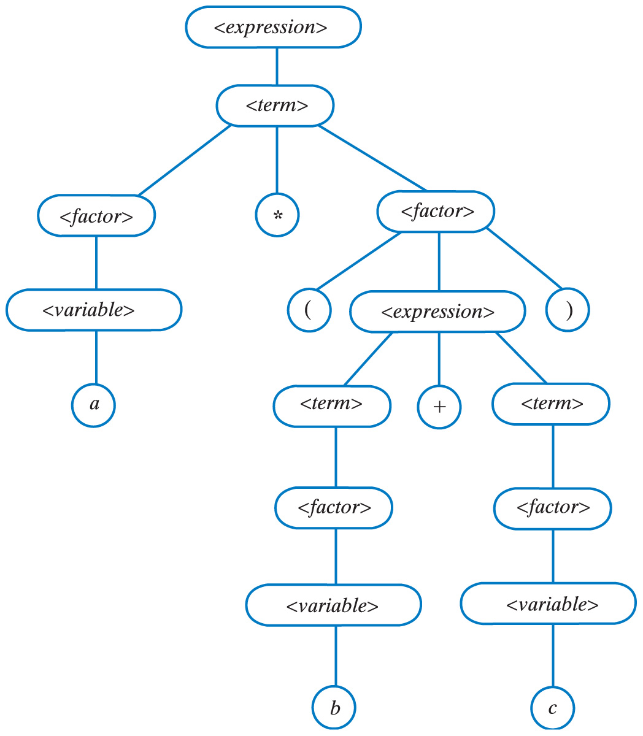
Examples of General Trees
Fig. 25-21 A parse tree for the algebraic
expression
a * (b + c)
Carrano, Data Structures and Abstractions with Java, Second Edition, (c) 2007 Pearson Education, Inc. All rights reserved. 0-13-237045-X

Slide 36
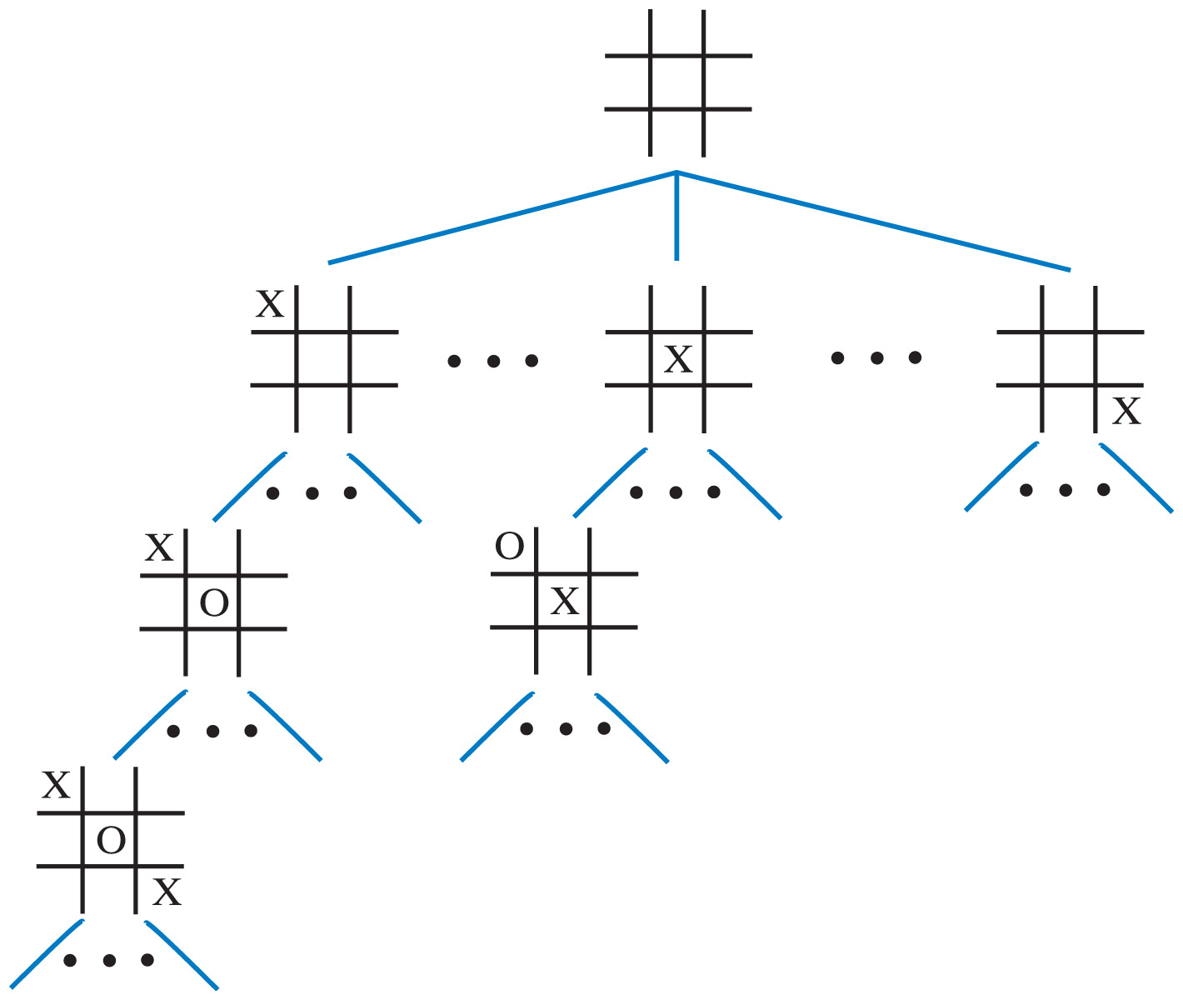
Examples of General Trees
Fig. 25-22 A portion of a game tree for tic-tac-toe
Carrano, Data Structures and Abstractions with Java, Second Edition, (c) 2007 Pearson Education, Inc. All rights reserved. 0-13-237045-X

